Slide 1
Workforce Conditions for Veterans in Maine
Ruth Pease
Principal Economic Research Analyst
Center for Workforce Research
Maine Dept. of Labor
Ruth.E.Pease@maine.gov
207-621-5189
May 23, 2018

Slide 2
Unemployment and labor force participation rates differ among demographic groups, which is important to consider when comparing workforce conditions for veterans and non-veterans. Veterans are: • 93% male (Maine) • Older than the general adult population • More likely to have a disability that prevents them from being in the labor force (those not looking for work are not counted as unemployed — they are not in the labor force). Maine has a lot of Veterans: • 112,000 age 18+ population, the 10th highest share in U.S.
Notes:
First 3 bullets:
Source: U.S. Census Bureau, 2012-2016 American Community Survey 5-Year Estimates
Disability Status: from 2012-2016 ACS, 30.5% of veterans with any disability v 17.% of non-veterans
Number of Veterans and state rank:
Maine Veterans: https://www.bls.gov/news.release/pdf/vet.pdf table 6A

Slide 3
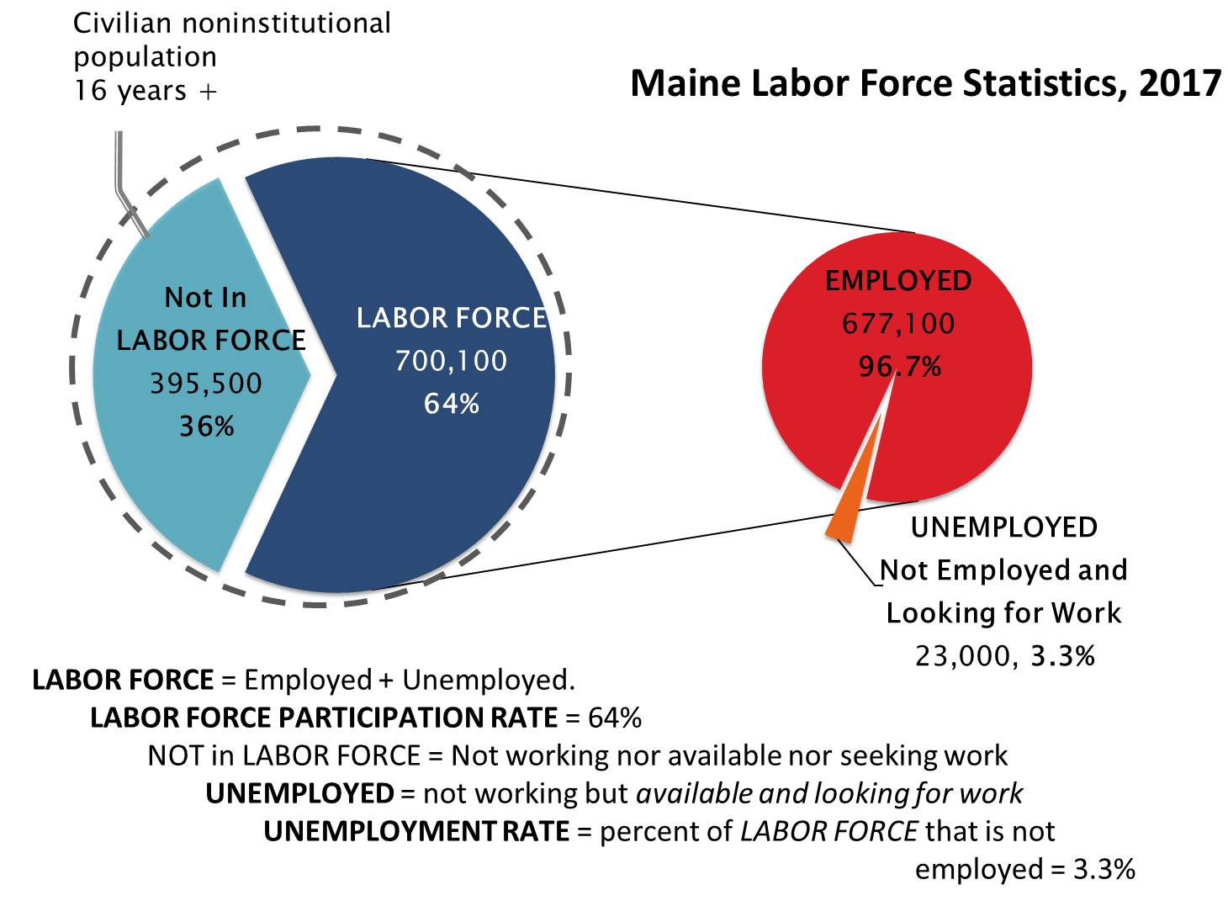

Slide 4
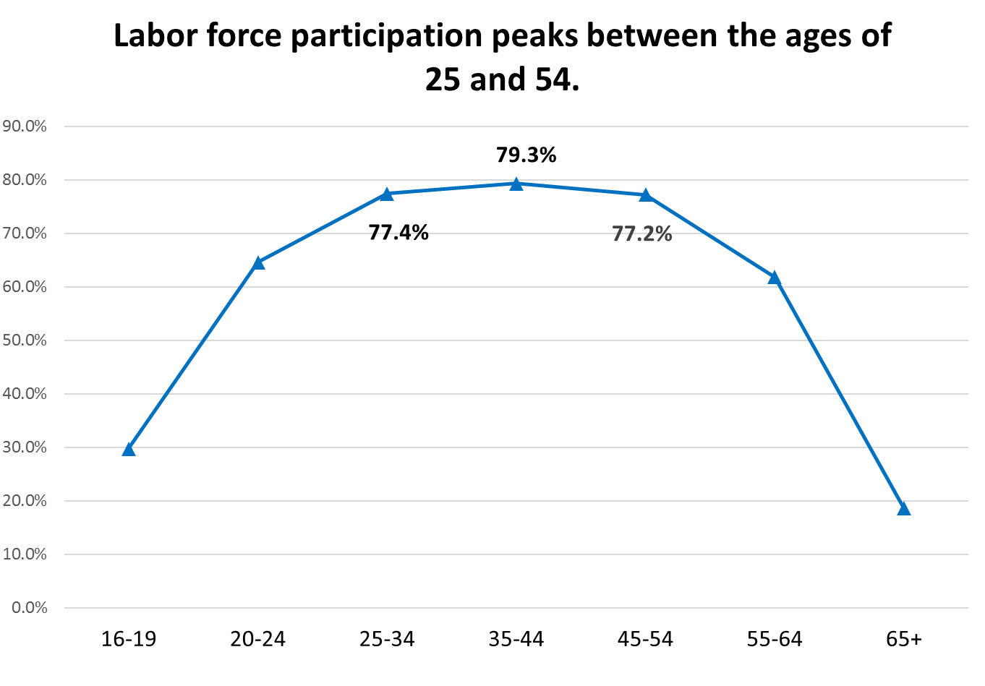

Slide 5
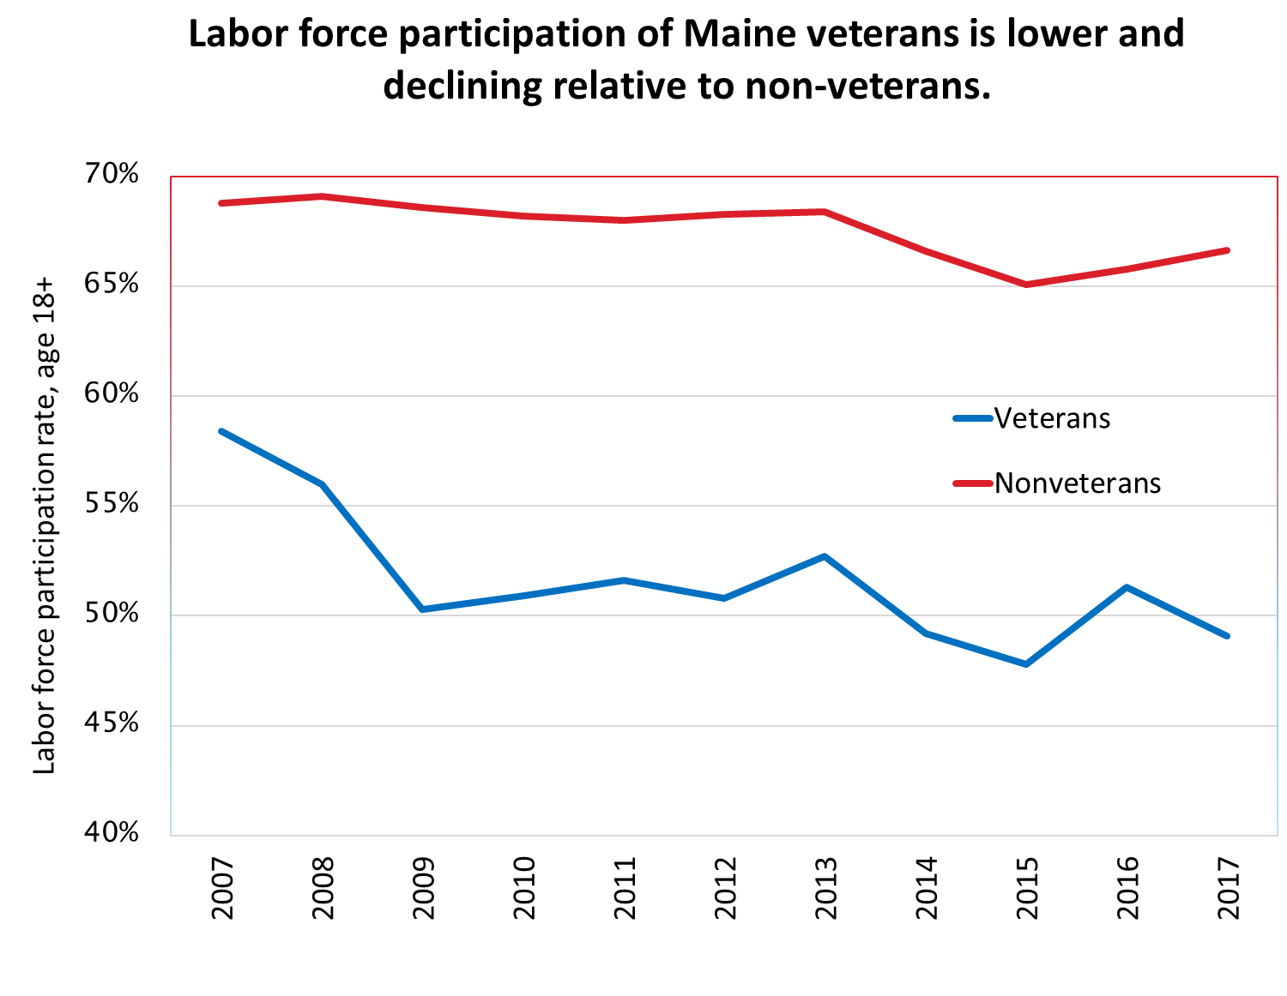
Notes:
http://www.maine.gov/labor/cwri/data/cps/Excel/Employment_Status_of_Veterans_versus_Non-Veterans.xlsx

Slide 6
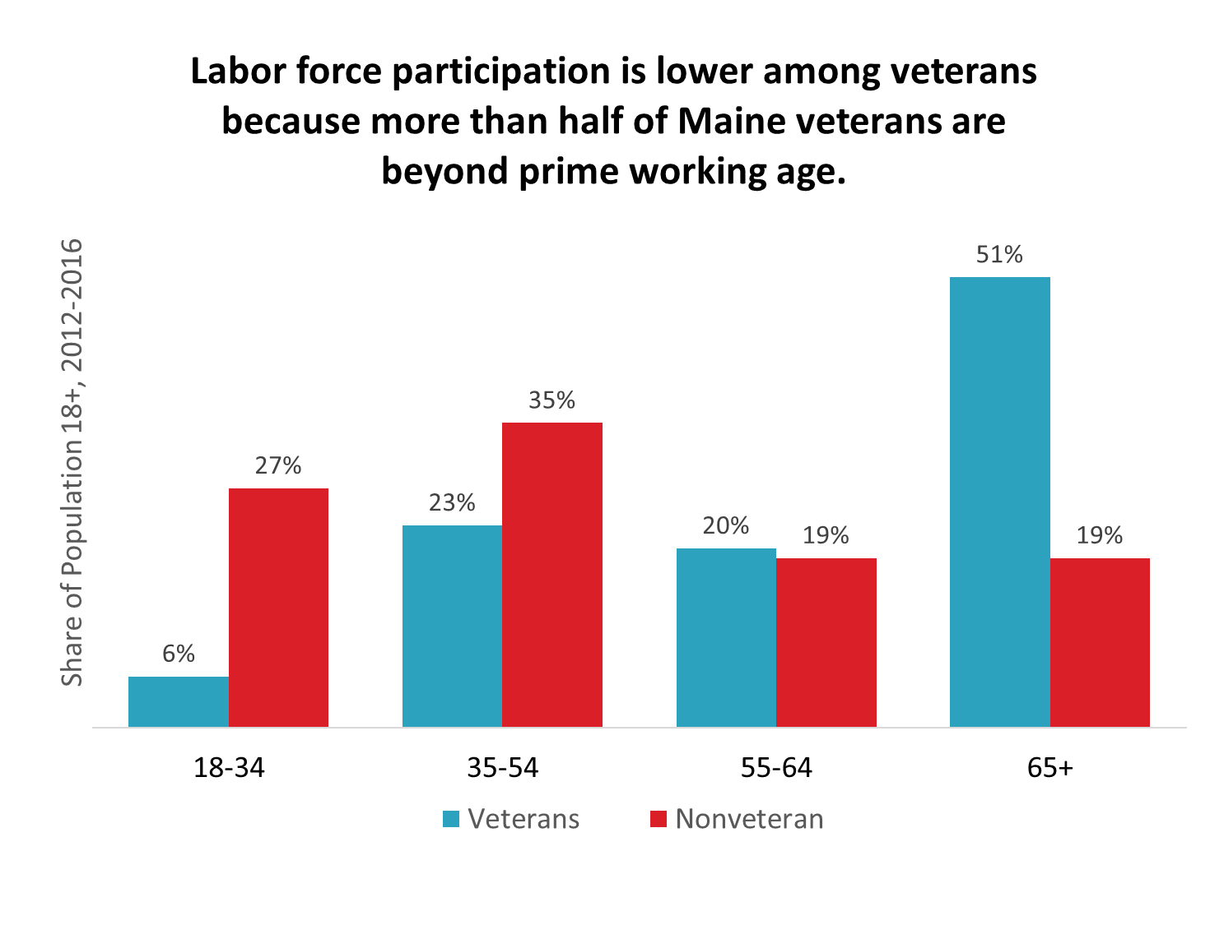
Notes:
Source ACS 2012-2016, Table S2101

Slide 7
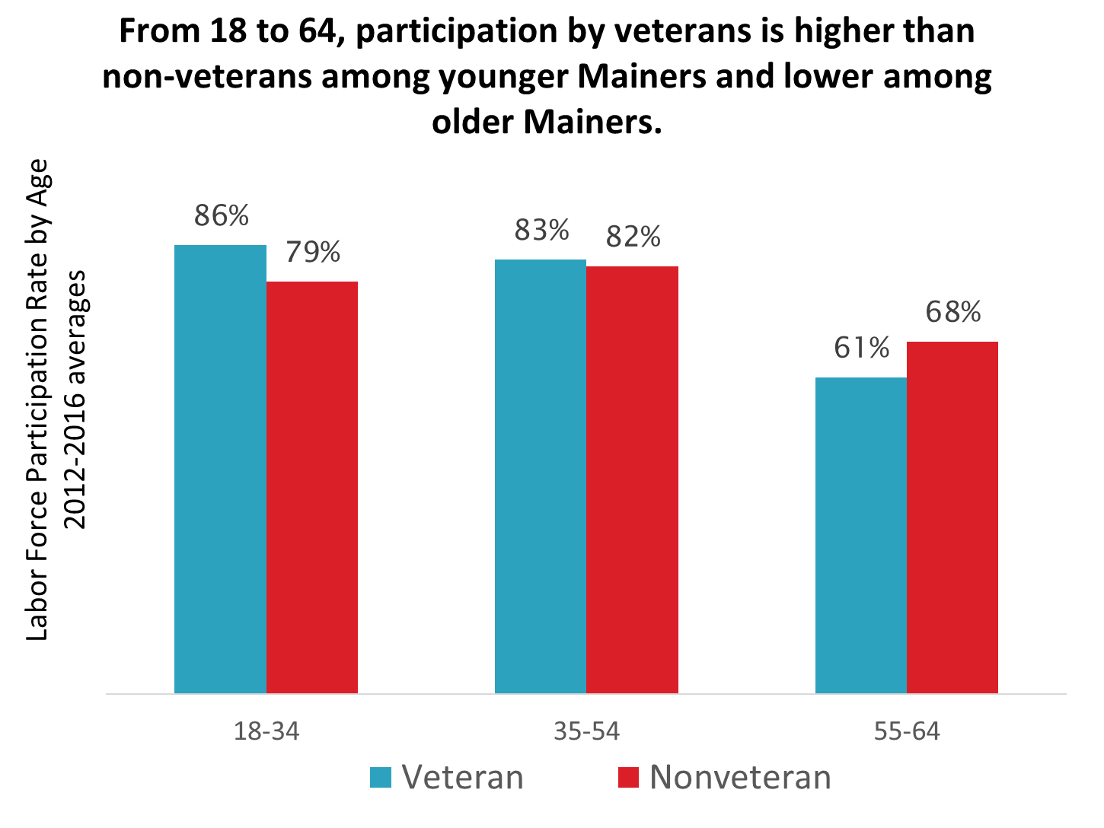

Slide 8
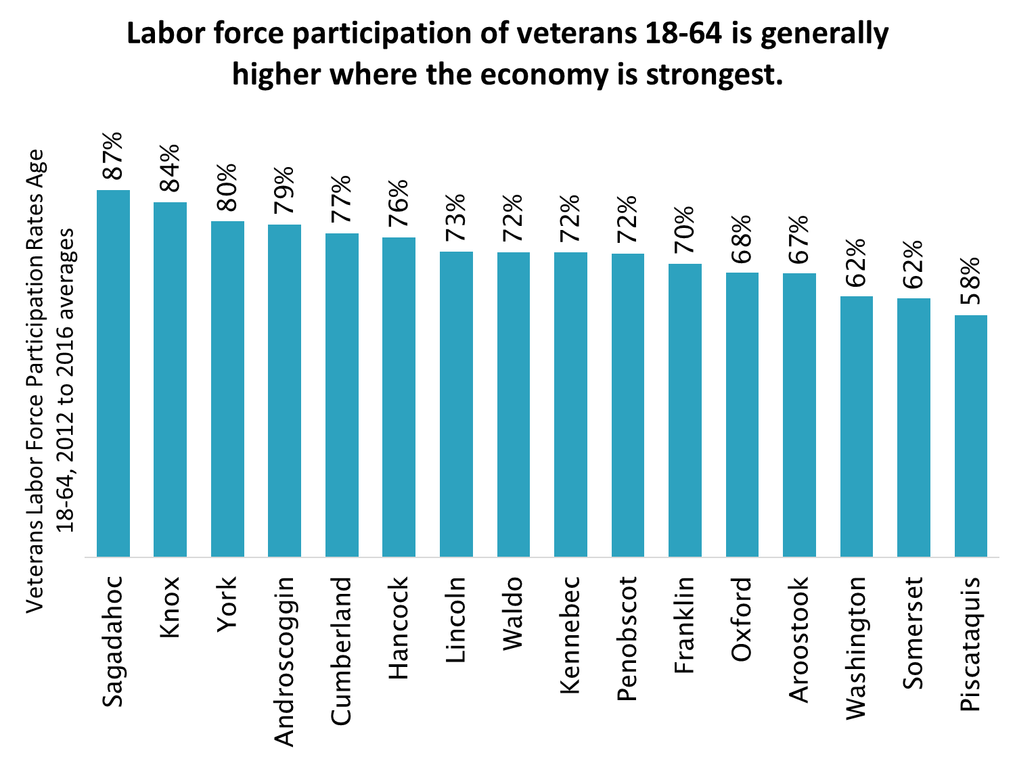
Notes:
Source: U.S. Census Bureau, 2012-2016 American Community Survey 5-Year Estimates Table S2101

Slide 9
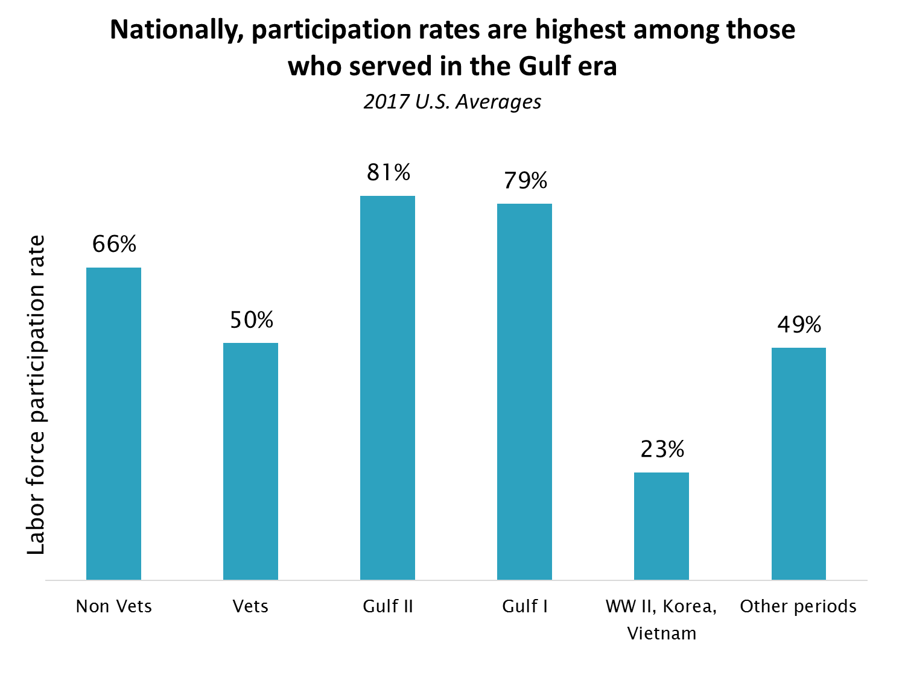
Notes:
Information from https://www.bls.gov/news.release/pdf/vet.pdf Table A

Slide 10
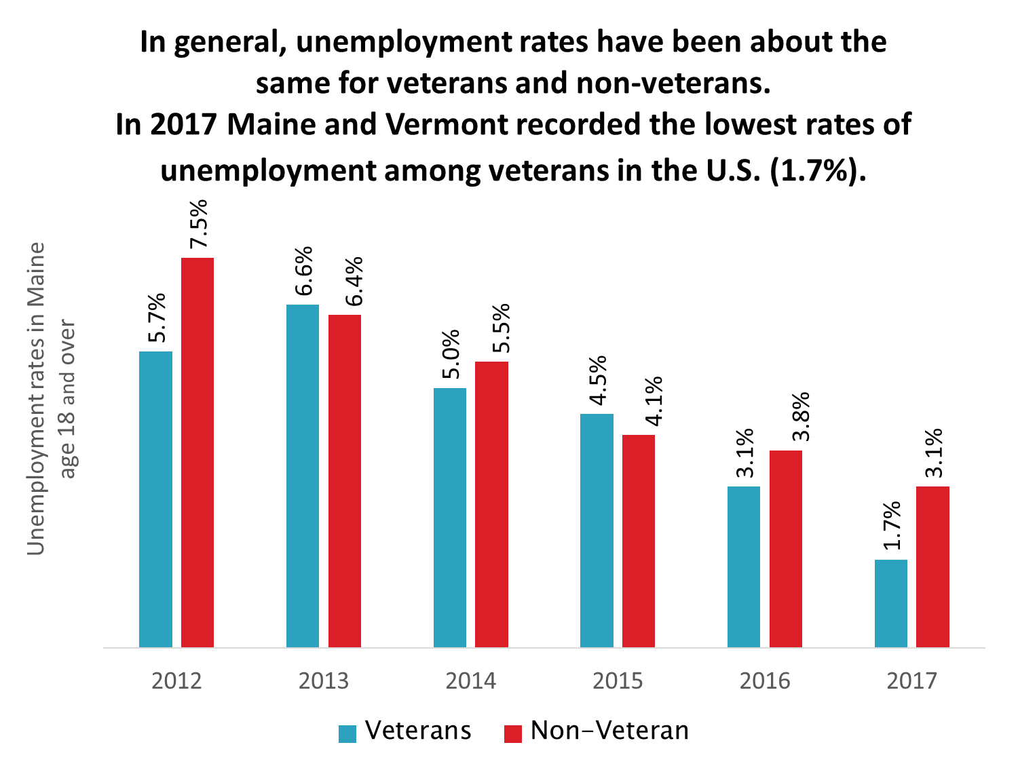

Slide 11
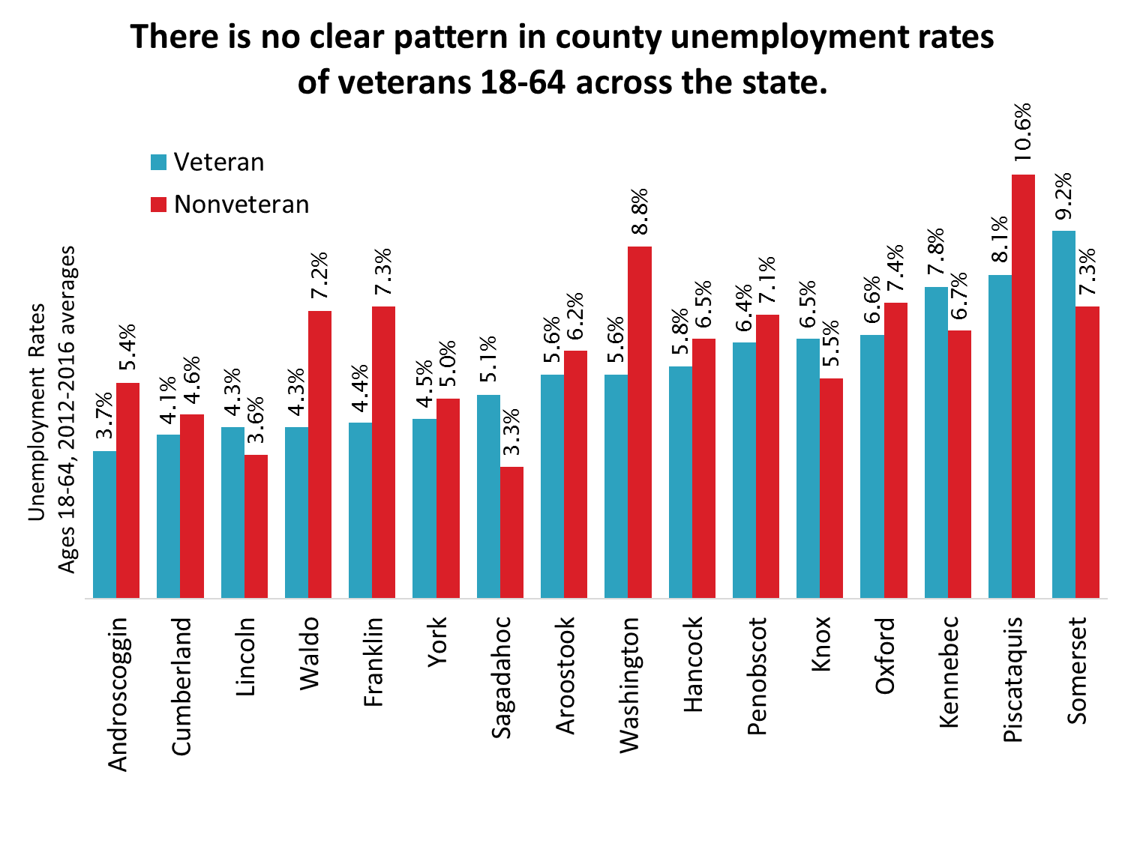
Notes:
Source: U.S. Census Bureau, 2012-2016 American Community Survey 5-Year Estimates Table S2101

Slide 12
Veterans and disability status
Service-Connected
Functional
Based on VA determination.
A factor in determining disability payments (not all receive payments)
Not necessarily functionally disabled.
VA’s definitions tend to be broader than functional categories.
Self-reported “difficulty or serious difficulty” with activities of daily life.
Based on responses to ACS survey question(s).
Impairments may restrict ability to work.
Notes:
hearing, seeing, remembering, moving, self-care or independent living

Slide 13
“The relationship between having a functional disability and receiving a VA disability rating is complex.”
(Labor Force Experiences of Recent Veterans, May 2017, Congressional Budget Office)
The CBO analyzed male Gulf II veterans ages 22 to 44 during the years 2008-2015. Of these:
About one-quarter of the Gulf War II veterans with a VA disability rating in CBO’s data reported themselves as functionally disabled
Among those with a VA disability rating of 70 percent or higher, nearly half reported that they were functionally disabled.
Of veterans who reported a functional disability, only about two-thirds had a VA disability rating.
There are several possible reasons for that: They did not apply for VA benefits, they applied but their claims were still being adjudicated, or they became disabled after leaving military service.

Slide 14
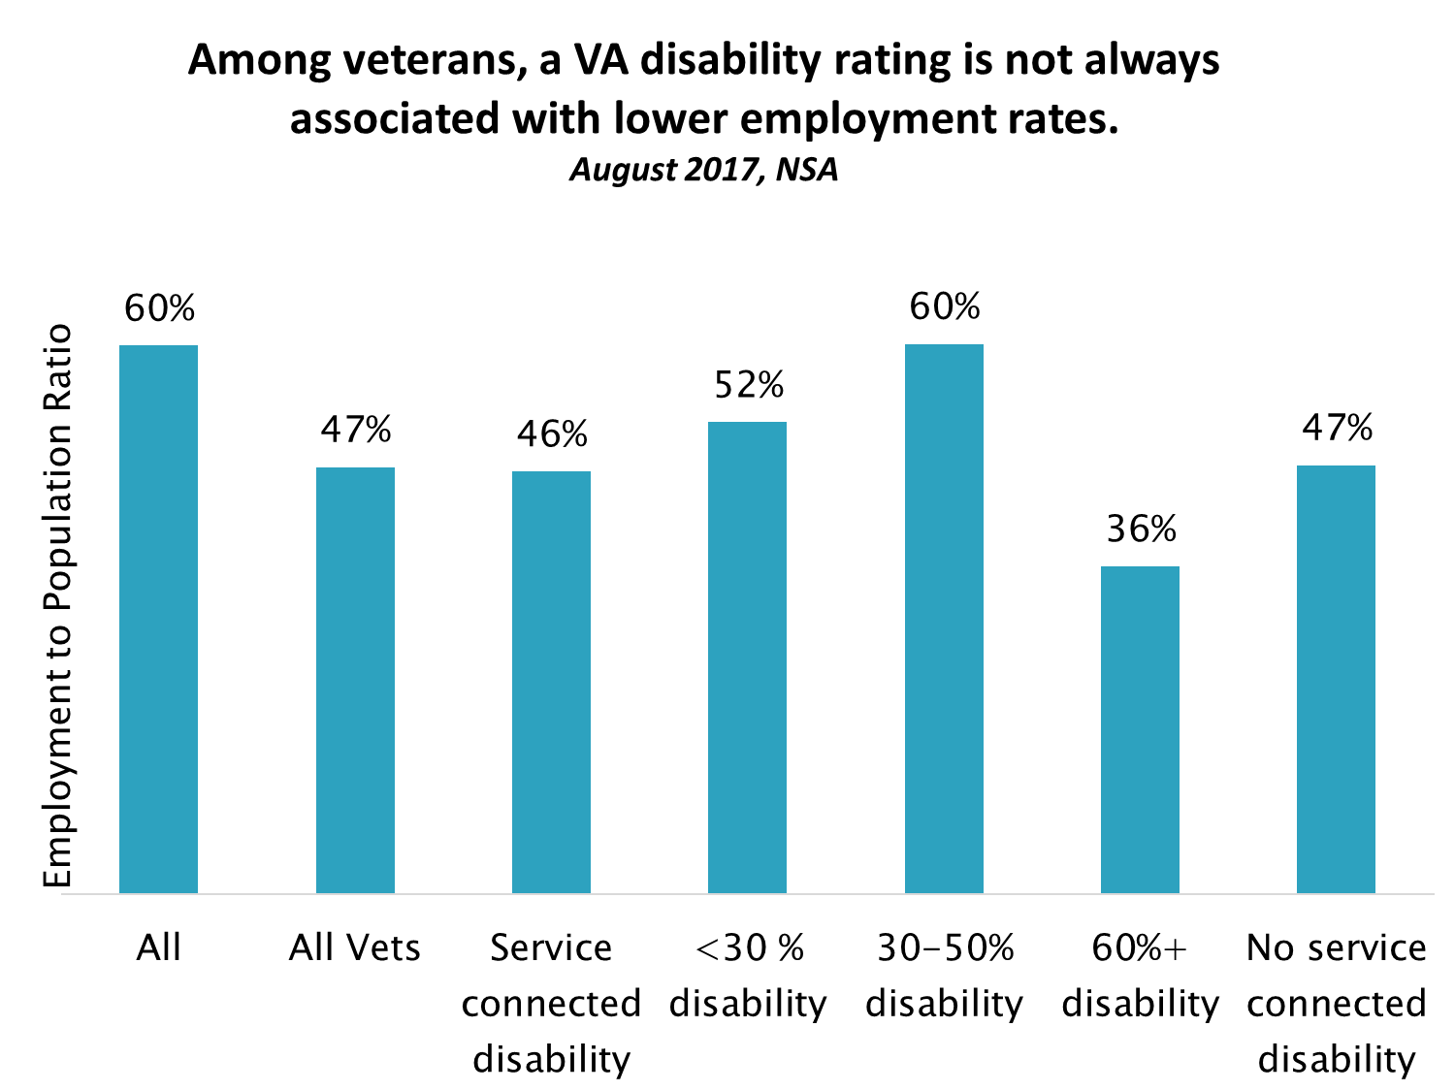
Notes:
https://www.bls.gov/news.release/pdf/vet.pdf Table 7 (August, 2017 NSA)
“All” from bls.gov table: LNU02300000

Slide 15
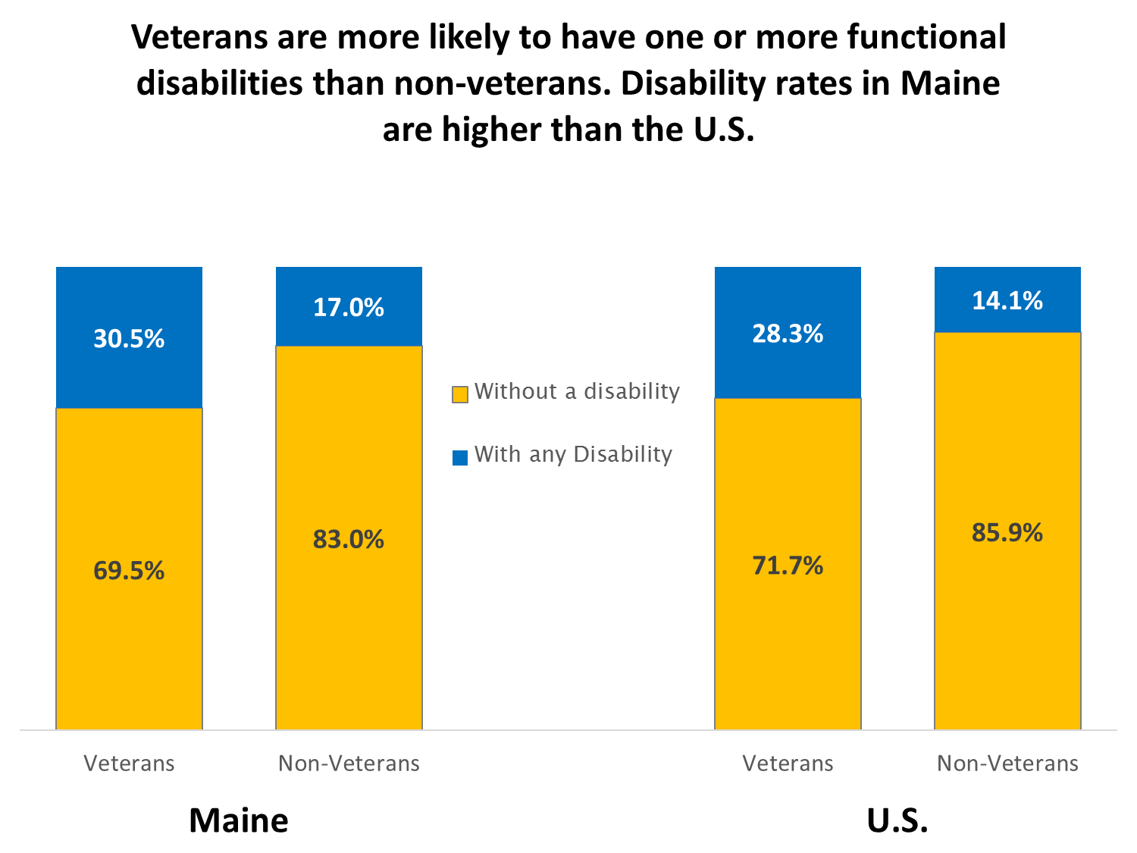
Notes:
ACS 2012-2016 Table S2101

Slide 16
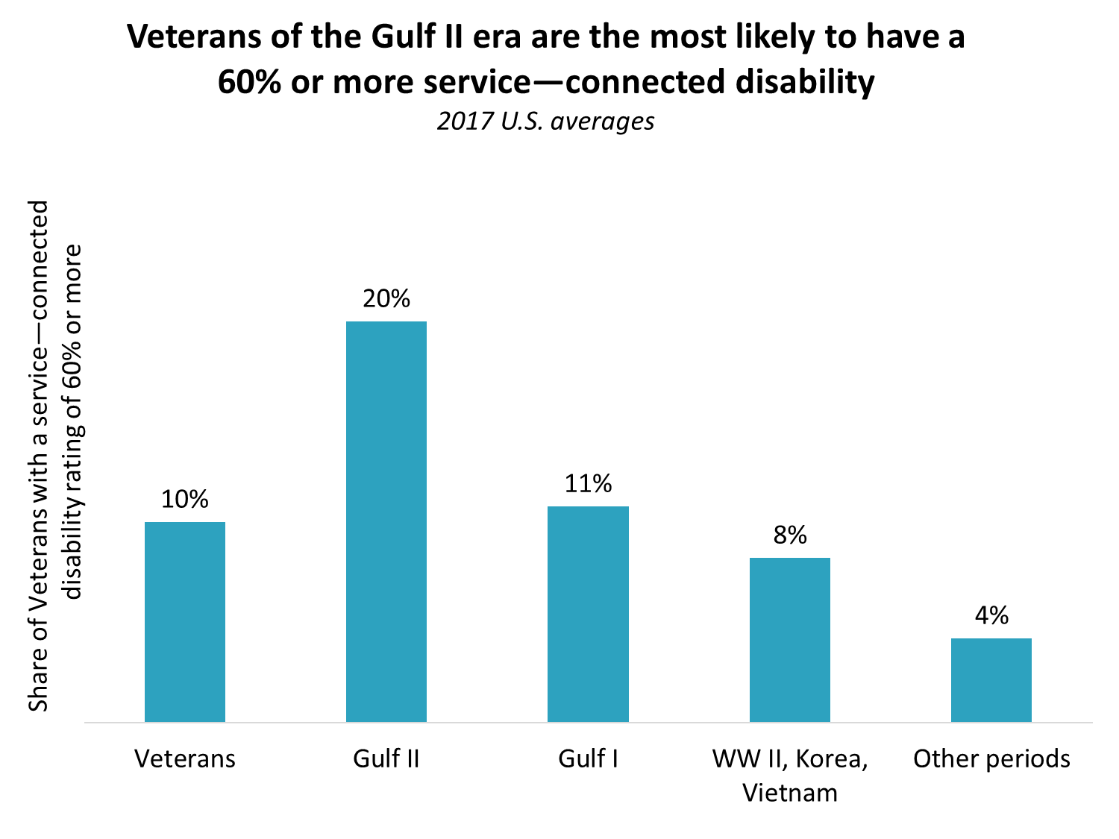
Notes:
https://www.bls.gov/news.release/pdf/vet.pdf table 7

Slide 17
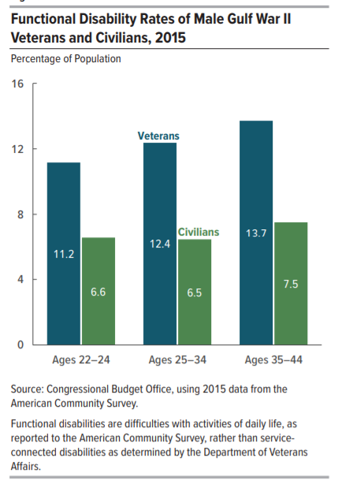
“According to 2015 data from the ACS, male Gulf War II veterans had a higher prevalence of functional disabilities
than civilian men.”
“Although recruits must meet the military’s health and fitness standards, serious injuries and medical impairments may be more common
among Gulf War II veterans than among civilians because of veterans’ intensive physical training and, in some cases, their combat experiences.”

Slide 18
Key Differences identified by CBO between male Gulf War II veterans ages 22 to 44 and their non-veteran peers
Age distribution (a higher share of veterans are younger)
Educational attainment (more veterans with HS diploma)
Citizenship (more veterans are citizens)
Race/Ethnicity (veterans more likely to be white)
Enrollment in post-secondary school (many veterans return to school)
Geographic location (more likely to live in the Southern U.S.)
Rates of functional disability (elevated among veterans)
Other unique factors that may affect labor force outcomes:
Military experience (selection, tenure, training)
Employer’s hiring preferences (variable affect on opportunity)
Service-connected disabilities (incentives and disincentives)
Challenges in transitioning to the workforce
Source: Labor Force Experiences of Recent Veterans, Congressional Budget Office, May 2017, found at https://www.cbo.gov/system/files/115th-congress-2017-2018/reports/52418-laborforceveterans_0.pdf

Slide 19
Questions?
Problems?
If you experience problems viewing CWRI website content, try a different internet browser.
For more information or help finding or interpreting LMI data, contact
Ruth Pease at ruth.e.pease@maine.gov or at 621-5189

